Slide 1
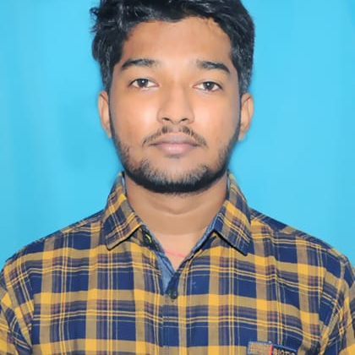


MYTHRESH SAI MAHADEV UDATHA
Analyst/Software Engineer
Bachelor of Engineering
Mechanical Engineering : 2017 - 2021
Skills
Java 8 /J2EE | Java Basics, OOPS, Generics, Collections, Arrays, Loops, Lambda Exp, Stream API
Spring core | IOC & Dependency Injection, Autowire
Spring REST | REST controllers, Implementation of GET, POST, PUT & DELETE, Bean Validation & Exception Handling ,Controller & Repository layer
Spring Data JPA | Implement DAO layer using spring Data repositories, Transaction Management
Spring Boot Microservices | Spring Boot Starters, annotations, Messaging Service , Swagger API documents
Spring Cloud | Eureka, Netflix Hystrix, Netflix Zuul
React | Components, Hooks, Event handling
Database | PostgreSQL
UI Tech | HTML 5 & CSS 3,JavaScript
Tools | Git, Postman, Maven, eclipse IDE, Visual Studio Code
Add On skills | Communications, Team management. Peer learning
Bangalore
Mythresh.udatha@capgemini.com
+91 8317551708
A4
Full Stack Developer
Hands on experience in creating microservices with Spring boot, Spring Security, Netflix Zuul API Gateway, Eureka server
Hands on experience in creating DDL,DML,DCL,DQL in Postgres SQL
Git & GitHub knowledge on an intermediate level
Knowledge on HTML, CSS and React
Ready to learn new technologies and implement them to further improve my knowledge
Neo bookstore
On Demand Car Wash
Backend Developer:
In our project we have used Spring Boot Framework of core java for backend development.
Designed UML diagrams based on given requirements..Used Spring boot to perform backend tasks. We used Spring data JPA for creation of entites in PostgreSQL..Done unit testing for all the possible use cases by postman tool.
Expense Tracker
Front Developer:
In our project we have used HTML, CSS, JS and ReactJs for front development. We can add new expense to expenses tracker, and we can see all expenses in the expense tracker. We used vscode and node.js to create the expense tracker project.
Check out my work on GitHub

